Slide 1
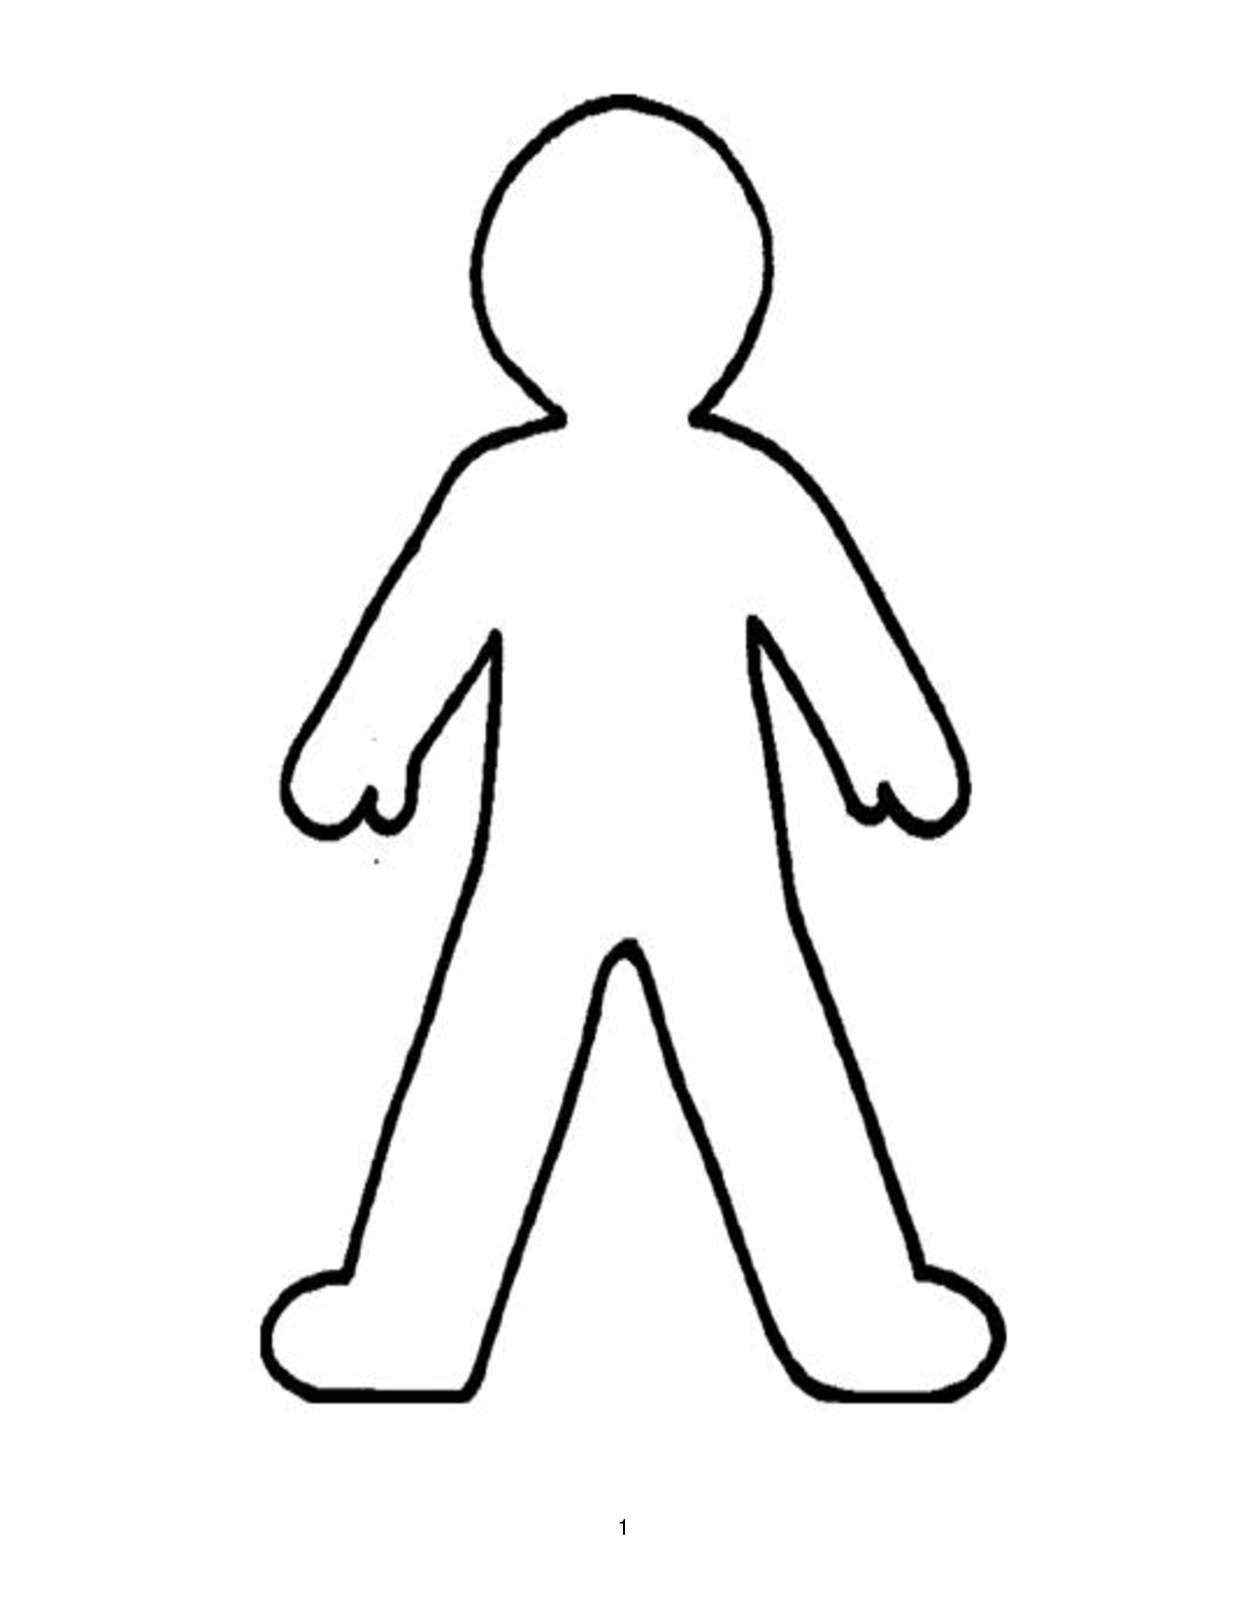
Title: Virtue ethics
Draw an outline of a person
Within the outline write all the qualities that a person needs to be a ‘good’ person
Around the outside of your person, write all the qualities that a good person should not have

Slide 2
What qualities did you come up with?
Are these qualities the same at all situations?
Do you think these qualities are the same for all people?

Slide 3
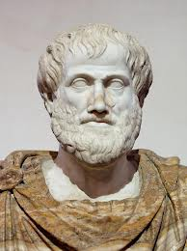
Virtue ethics
Virtue ethics comes in many different forms. We are going to focus on Aristotle.
Aristotle thought that ethics was not about what is right or wrong. Instead, ethics is about how to become a good person.

Slide 4
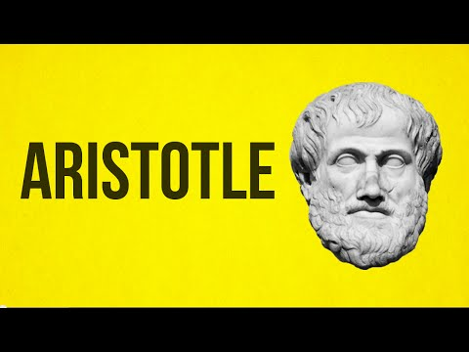
As you watch answer the questions on your sheet
Notes:
Watch until 3.00. Answer questions on the sheet - pause and explain when necessary. Or just watch the video.

Slide 5
Step by step look at Aristotle’s virtue ethics
Read through Aristotle’s virtue ethics.
Cup with at least three strengths and three weaknesses of Aristotle’s virtue ethics.
We are going to do the first one together.
Strengths - What is good about virtue ethics? | Weaknesses - What is bad about virtue ethics?
Notes:
Model on the other slide

Slide 6
Strengths - What is good about virtue ethics? | Weaknesses - What is bad about virtue ethics?
Notes:
Macro enabled – can write on the slide while in presentation mode

Slide 7
Context - The Nicomachean Ethics is either dedicated to Aristotle’s father or his son who were both called Nichomachus. Aristotle’s audience is comprised of spoudaioi meaning ‘serious’ human beings. These were citizens of Greek city states: adults who governed each city. The majority of the population was made up of slaves, non-citizen labourers, , women and children. | Strengths - What is good about virtue ethics? | Weaknesses - What is bad about virtue ethics?
Step 1: Aristotle argues that the goal of human beings is to achieve eudemonia (human flourishing/happiness).
Step 2: According to Aristotle we do this through developing virtues. Aristotle thought there were 12 moral virtues. These virtues are the ‘golden mean’ between a vice of excess and deficiency.
Step 3: Aristotle argues that we can develop virtues through habit. As Aristotle writes, “We are what we repeatedly do. Excellence, then, is not an act, but a habit. …. Moral excellence comes about as a result of habit. We become just by doing just acts, temperate by doing temperate acts, brave by doing brave acts.”
Step 4: What is the golden mean depends on the situation: ‘Conduct and questions of what is good for us have no fixity’. Aristotle gives the example of courage, in which the man who is fearful of everything becomes a coward.
Step 5: Finally, Aristotle argues that one should not just be virtuous for themselves, but for the good of the community.
Vice of deficiency - | Virtue/Virtuous mean | Vice of excess +
Cowardice | Courage | Rashness
Indulgence | Temperance | Abstinence
Meanness | Generosity | Wastefulness
Pettiness/Stinginess | Magnificence | Tastelessness
Self-deprecation | High-mindedness | Vanity
Want of ambition | Right ambition | Over ambition
Apathy | Good temper | Irritability
Understatement/false modesty | Honesty | Boastfulness
Boorishness | Wittiness | Buffoonery
Surliness | Friendliness | Flattery
Shamelessness | Modesty | Shyness
Spitefulness | Just resentment | Envy
Aristotle’s virtue ethics
Notes:
One each

Slide 8
In your groups, you have been given a case study
Read through the case study – these case studies are all real.
What would a virtue ethicist do in this situation?
What virtues might you cultivate by acting or not acting?
What are the implications for the community? Would this make the community better or worse?

Slide 9
Now have a look back at your tables of pros and cons of virtue virtues.
Now you have applied virtue ethics to some ethical situations – what can you add to your table?

Slide 10
What would a virtue ethicist do in this situation?
What virtues might you cultivate by acting or not acting?
In England, 4.7 billion plastic straws, 1.8 billion cotton buds with plastic stems and 316 million plastic stirrers are used every year. The plastic waste that results from these single-use items damages the environment. To address this, legislation was implemented in October 2020 that bans businesses in England from supplying single-use plastic straws, cotton buds and drink stirrers to customers. This policy has received wide support and a similar ban is being considered in Scotland. Although these single-use plastics form only a small part of our negative impact on the environment, eliminating them seems a relatively easy way to treat the planet better. However, disability activists have complained that for many people abandoning plastic straws is not an option. Some people with disabilities rely on straws to drink safely and without assistance. Straws made of alternative materials are often not suitable: metal, glass and bamboo straws can lead to injuries, and paper and pasta straws can disintegrate and form choking hazards. Moreover, reusable straws are more expensive and are hard to clean for persons with certain disabilities. The plastic straw ban in England does include an exemption for disabled persons: although catering establishments cannot make straws visible or freely available, they can supply them when requested by customers. Activists argue that such an opt-in system still harms disabled persons: they are now required to disclose their disability to strangers and are dependent on staff members believing they need a straw. This puts a burden on people to always plan ahead and bring their own straw or risk not being able to drink.
What are the implications for the community? Would this make the community better or worse?
Notes:
A3 one/two per table

Slide 11
What would a virtue ethicist do in this situation?
What virtues might you cultivate by acting or not acting?
Tail docking, the shortening of a dog’s tail, was banned in Scotland in 2007 under the Animal Health and Welfare Act 2006. However, in 2018 Scotland approved a change which permitted “tail shortening by a third” for working dogs used in the lawful shooting of animals. Two breeds are currently covered by this modification: spaniels and hunt point retrievers. The procedure is performed by a veterinarian on puppies under 5 days old. The practice of tail docking is fully banned everywhere else in the U.K. The Scottish Gamekeepers Association argues that the tail docking practice is a “quick preventative procedure protecting the animal over its whole working life”. In the 2006 parliamentary sessions, Liberal Democrat MSP John Farquhar Munro argued that no dogs were worse off as a result of tail docking and that such a traditional practice prevents tail injuries, thus benefitting the animal. In 2020, Green Party MSP Mark Ruskell said that he hopes to bring back the full ban as part of new animal welfare laws. He argues that cutting off the tails of thousands of puppies to appeal to a “bloodsports lobby” is despicable. Various reasons are invoked against tail docking, including that it is an outdated tradition, that it goes against the welfare of the animal, and finally, that it is impossible to know which puppies from a litter will be selected to be working dogs, thus leading to performing a painful procedure on dogs who might not become working dogs.
What are the implications for the community? Would this make the community better or worse?
Notes:
A3 one/two per table

Slide 12
What would a virtue ethicist do in this situation?
What virtues might you cultivate by acting or not acting?
Global warming is a looming disaster. It seems as though every week a new study comes out warning us that the situation is worse than we thought, and in 2015 the global temperatures hit a mean of 1 degree above pre-industrial levels. Meanwhile, the Paris Climate Accords saw almost all of the world’s nations agree to limit global warming to within 2 degrees Celsius above pre-industrial levels, but many scientists now warn that even hitting 1.5 degrees above will have catastrophic consequences, and despite the Paris agreement we still seem to be on course to not only hit the 2 degree mark but to exceed it by four degrees by the end of the century. Because of this kind of finding, many are dissatisfied with what they perceive as a lack of real action on behalf of our political leaders. In November 2018, climate protesters glued themselves to the gates of Downing Street, resulting in 27 arrests. Despite the action being disruptive and illegal, some politicians, including the Green Party peer Jenny Jones, supported the action. We may see acts of this sort becoming increasingly frequent as the scientific evidence builds. There is a rich history of civil disobedience in the face of injustices. For example, in 1955, in the prelude to the Montgomery bus boycott, Rosa Parks was asked to give up her seat so that white people could sit down. She was arrested and convicted of violating segregation laws. Because of her resistance and the political actions that ensued, bus segregation was ruled unconstitutional in 1956. Despite her criminal behaviour, she is heralded as a hero of the civil rights movement.
What are the implications for the community? Would this make the community better or worse?
Notes:
A3 one/two per table

Slide 13
When and where was Aristotle born?
Aristotle was the tutor to_________
Aristotle founded the_____________
Aristotle wanted people to identify and nurture_______
Aristotle’s ethics is recorded in a book edited by his son. The book is called____________
Aristotle identified ________virtues
Virtues are in the middle between a _____of excess and a _____of_______
Moral guidance, according to Aristotle happens through ________
When and where was Aristotle born?
Aristotle was the tutor to_________
Aristotle founded the_____________
Aristotle wanted people to identify and nurture_______
Aristotle’s ethics is recorded in a book edited by his son. The book is called____________
Aristotle identified ________virtues
Virtues are in the middle between a _____of excess and a _____of_______
Moral guidance, according to Aristotle happens through ________
Notes:
Optional

